Slide 1
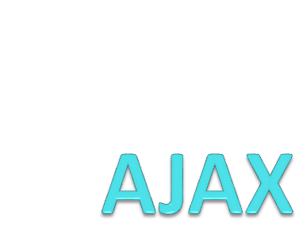
IK 2010-2018

Slide 2
AJAX
AJAX
What is AJAX?
What can AJAX applications do?
How can you develop AJAX applications?
IK 2010-2018

Slide 3
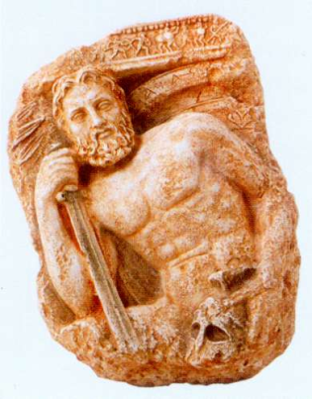
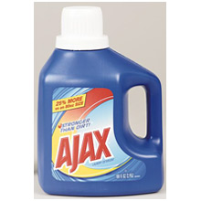

What is AJAX?
AJAX
A mythological Greek warrior.
A detergent label.
A football team from Amsterdam.
Asynchronous JavaScript And XML.
IK 2010-2018

Slide 4
What is AJAX?
AJAX
AJAX is a way to sent/obtained data to/from server by JS code.
AJAX is not a technology by itself.
It is a Web development technique, combining several existing technologies in a specific way:
  HTML,
  JavaScript, and in particular XMLHttpRequest, and
  (optionally) XML.
IK 2010-2018

Slide 5
What does AJAX Do, Anyway?
AJAX
AJAX applications provide a higher level of interactivity with end-users.
The user can interact with server-side content – without reloading the entire page.
IK 2010-2018

Slide 6
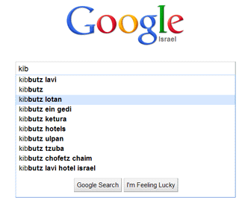
For Example: Google Suggest
AJAX
The input box offers suggestions as-you-type.
Clearly, Google’s entire database is not sent to the user’s computer…
IK 2010-2018

Slide 7
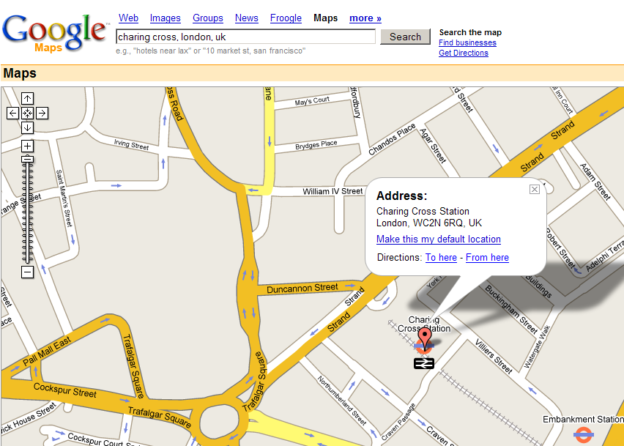
For Example: Google Maps
AJAX
If you drag the map sideways, information is loaded dynamically for newly-exposed areas.
IK 2010-2018

Slide 8
More Examples
AJAX
Forms that dynamically change their content as you make some selections – without preloading all data to your machine.
Discussion pages (“forums”) where you can “unfold” folded messages – without reloading the entire page; works even for messages that were not preloaded.
IK 2010-2018

Slide 9
The Running Theme is…
AJAX
In AJAX applications, HTML pages dynamically change their content.
AJAX applications provide new content for HTML pages from the server.
  No need to preload information to the browser.
IK 2010-2018

Slide 10
AJAX Advantages
AJAX
Applications more responsive to users.
Reduced server load.
  If used wisely; for example, only the new map parts are loaded in Google Maps; only the missing replies are loaded in the “forum” applications; etc.
  Conversely, Google Suggest certainly presents more server load than a simple input box.
IK 2010-2018

Slide 11
Why use AJAX?
AJAX
Mainly to build a fast, dynamic web application, but also to save resources.
For improving sharing of resources, it is better to use the power of all the client computers rather than just an unique server and network.
Ajax allows to perform processing on client computer (in JavaScript) with data taken from the server.
IK 2010-2018

Slide 12
AJAX Pros
AJAX
Increases usability of web applications, making them seem more responsive and interactive, thus enhancing the user experience.
Saves bandwidth - downloads only newly requested data, not the entire page.
Faster interfaces – if used properly and not overdone on a single page. One Page Application.
IK 2010-2018

Slide 13
AJAX Cons
AJAX
Breaks back button support (to some extent, this issue can be solved).
Since data to display is loaded dynamically, it is not part of the page, and the keywords inside are not used by search engines.
URL's don't change when the state of the application changes.
In asynchronous mode the page may change with delays (when the processing on the server takes some times), this may be disturbing.
IK 2010-2018

Slide 14
How Is It Done?
AJAX
The HTML page content is changed using the DOM innerHTML property.
  To properly use DOM is employed.
Content is retrieved from the server using the JavaScript function XMLHttpRequest.
IK 2010-2018

Slide 15
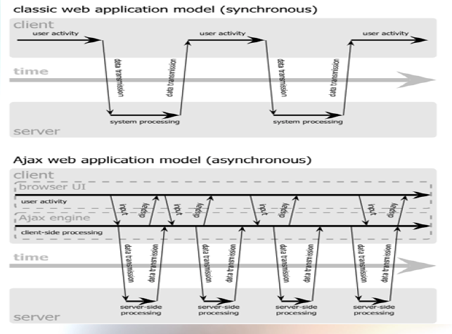
How does it work?
AJAX
IK 2010-2018

Slide 16
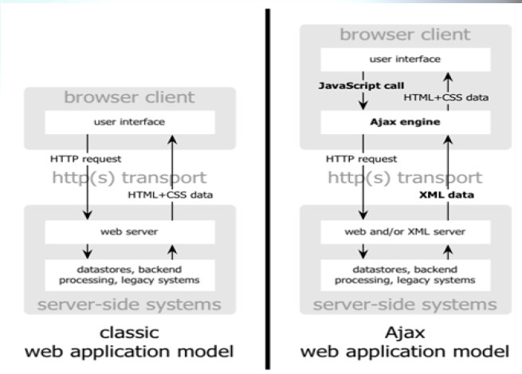
How does it work?
AJAX
(classic vs. Ajax)
IK 2010-2018

Slide 17
Using XMLHttpRequest
AJAX
The XMLHttpRequest object is a JavaScript object that sends an HTTP request to the server.
The server processes this request like any other HTTP request.
  No way of telling it from a simple browser request.
The result can then be used – e.g., as a new value for some node’s innerHTML!
IK 2010-2018

Slide 18
Does It Have To Be XML?
AJAX
If the request is called XMLHttpRequest, the content must be XML, right?
Wrong. The response sent from the server can be anything, including:
  XML,
  Full HTML pages,
  HTML fragments, -- especially useful!
  Text data…
IK 2010-2018

Slide 19
The Request Object
AJAX
XMLHttpRequest is not a simple function that directly returns a value.
Rather, it is a JavaScript class, and we must create an object to use.
  A new object for every request.
Once we have the object, we can send the request and (painfully) obtain the result.
IK 2010-2018

Slide 20
Obtaining the Request Object
AJAX
Sadly, a different mechanism must be used for obtaining the request object in different browsers.
The bad news: The bad-old-days of browser-detection days are back.
The good news: Three attempts will cover all browsers currently on the market.
IK 2010-2018

Slide 21
Creating the Request Object
AJAX
if (window.XMLHttpRequest) // Mozilla, Safari,...
http_request = new XMLHttpRequest();
else if (window.ActiveXObject) { // IE
try {
http_request = new ActiveXObject("Msxml2.XMLHTTP");
}
catch (e) {
try {
http_request = new ActiveXObject("Microsoft.XMLHTTP");
} catch (e) {}
}
}
if (!http_request) {
// … try to fail gracefully …
}
Note: Different books and web-sites present different code for a browser-independent way to obtain this object.
IK 2010-2018

Slide 22
Sending the Request
AJAX
To send the request, we use the open and send methods of the request object:
But some work must be done before the request is sent…
http_request.open(“GET”, “http://www.xyz.com/whatever”, true);
http_request.send(null);
IK 2010-2018

Slide 23
Obtaining the Result
AJAX
The request is sent asynchronously.
This way the HTML page is still responsive, and your JavaScript code keeps running, while the request object is waiting for a server response.
To obtain the result when it arrives, we must pre-arrange a callback function.
IK 2010-2018

Slide 24
Setting the Callback Function
AJAX
Before sending the request, we must set the request object’s onreadystatechange property.
This is easily done using JavaScript’s in-code function support:
http_request.onreadystatechange = function() {
// … the callback function goes here …
};
// … now use open() and send()
IK 2010-2018

Slide 25
When the Callback is Called
AJAX
You would expect the callback function to be called once, when the response is obtained.
However, it is called up to five times!
Each time, with a different HTTP State.
Inside the function, find the current HTTP state using the request object’s readyState property.
IK 2010-2018

Slide 26
Different HTTP States
AJAX
0 – Un-initialized (before open is called).
1 – Initialized, but not yet sent (before send is called).
2 – Was sent, but response not received yet (some HTTP headers might already be available).
3 – Partial data available.
4 – Complete response available.
IK 2010-2018

Slide 27
So When Is the Callback Called?
AJAX
Try this to find out:
States 0, 1 are not reported by many browsers.
States 2, 3 are reported by most browsers.
State 4 is always reported.
http_request.onreadystatechange = function() {
alert("state is " + http_request.readyState);
};
// … now use open() and send()
IK 2010-2018

Slide 28
For Example…
AJAX
http_request.onreadystatechange = function() {
if (http_request.readyState != 4)
return; // Just ignore earlier states – common practice.
if (http_request.status != 200) {
alret(“Server reported error code: ” +
http_request.status);
return;
}
n = document.getElementById(“nodeID”);
n.innerHTML = http_request.responseText;
};
http_request.open(“GET”, “http://x.com/foo”, true);
http_request.send(null);
IK 2010-2018

Slide 29
Down to Business…
AJAX
Clearly, the most interesting state is 4.
When this state is reached, we have the real content from the server!
It is accessible via the request object’s responseText property.
  Also, the status property can be used to detect errors, such as 404.
IK 2010-2018

Slide 30
The XMLHttpRequest object
AJAX
To get data from the server, XMLHttpRequest provides two methods:
- open: create a connection.
- send: send a request to the server.
Data furnished by the server will be found in the attributes of the XMLHttpRequest object:
- responseXml for an XML file or
- responseText for a plain text.
IK 2010-2018

Slide 31
XMLHttpRequest Properties
AJAX
We have to wait for the data to be available to be able to process it. The state of availability of the data is indicated by the readyState attribute of XMLHttpRequest.
States of readyState follow (only the last one is really useful):
0: not initialized.
1: connection established.
2: request received.
3: answer in process.
4: finished.
IK 2010-2018

Slide 32
The XMLHttpRequest class
AJAX
Attributes:
  readyState: the code sequentially changes value 0 – 4 for each state of the XMLHttpRequest object.
  status: 200 is OK, 404 if the page is not found.
  responseText: holds loaded data as a string of characters.
  responseXml: holds an XML loaded file, DOM's method allows to extract data.
  onreadystatechange: property that takes a function as value that is invoked when the readystatechange event is dispatched.
IK 2010-2018

Slide 33
The XMLHttpRequest class
AJAX
Methods:
  Open – initialize a new request for the object.
  Usage:
    open(mode, url, [boolean], [username, password])
      mode: type of request, GET or POST.
      url: the location of the file, with a path.
      boolean: true (asynchronous) / false (synchronous).
      username and a password.
IK 2010-2018

Slide 34
The XMLHttpRequest class
AJAX
Methods:
  Send – Sends the request.
  Usage:
    send(content)
      content: content to be passed as POST variable, use null for a GET command.
IK 2010-2018

Slide 35
The XMLHttpRequest class
AJAX
More methods:
  abort() – Cancels the current request.
  getAllResponseHeaders(headerName) – Returns the HTTP headers as a string.
    headerName: Returns the value of the specified HTTP header.
    Pass null or none, to return the complete set of HTTP headers as a string.
  setRequestHeader(label, value) - Adds a label/value pair to the HTTP header to be sent.
IK 2010-2018

Slide 36
AJAX– simple example
AJAX
This is a simple form, with text field. Using AJAX, we will fetch some data to <div>, when something is inputted by the user in Field1.
In the next slides, you`ll learn how to create an XMLHttpRequest object, which is used to communicate asynchronously with the server.
IK 2010-2018

Slide 37
AJAX - Simple Example
AJAX
//first, you need to create the XMLHttpRequest object
var ajaxRequest; // The variable that makes Ajax possible!
function ajaxFunction(){
try{
// Opera 8.0+, Firefox, Safari
ajaxRequest = new XMLHttpRequest();
} catch (e) {
// Internet Explorer Browsers
try{
ajaxRequest = new ActiveXObject("Msxml2.XMLHTTP");
} catch (e) {
try {
ajaxRequest = new activeXObject("Microsoft.XMLHTTP");
} catch (e) {
// Something went wrong
alert("Your browser broke!");
return false;
}
}
}
IK 2010-2018

Slide 38
HTML Code
AJAX
<input type="text" id="keyWord">
<input type="button" value="push me“ onclick="takeIt()">
<div id="result"></div>
Callback function
http_request.onreadystatechange = function() {
if (http_request.readyState != 4) return;
if (http_request.status != 200) {
alret("Server reported error code: " + http_request.status);
return;}
n = document.getElementById("result");
n.innerHTML = http_request.responseText;
}
IK 2010-2018

Slide 39
AJAX
Call function
function takeIt(){
document.getElementById("result").innerHTML="";
http_request.open("GET", document.getElementById("keyWord").value+".html" , true);
http_request.send(null);
{
IK 2010-2018

Slide 40

By Igor Kanovsky
Fall 2015
IK 2010-2018

Slide 41
The simplest way to use
Add some html from server:
Add and execute some JS from server:
$('#target').load('some-url.html');
$.getScript('some-url.js');
IK 2010-2018

Slide 42
Simple GET
Text from the server will be shown in the element with id=‘output’
$.get( 'some-url', // The URL to call
function(data) { // Success event handler
// The data parameter contains the string
$('#output').text(data);
}
);
IK 2010-2018

Slide 43
POST - sending data
var person = { firstName: 'Christopher', lastName: 'Harrison' };
// Call POST
$.post('URL', // Pass in the URL you need to access
person, // Pass in the data to send via POST
function(data) { // success event handler
// parameter contains value returned by server
}
);
IK 2010-2018

Slide 44
ajax() – a lot of options
Function $.ajax() has a lot of options to defined different variations of client-server communication
$.ajax({
method: "POST",
url: "some.php",
data: { name: "John", location: "Boston" }
})
.done(function( msg ) {
alert( "Data Saved: " + msg );
});
IK 2010-2018

Slide 45

IK 2010-2018

Slide 46
JSON
AJAX Frameworks
JSON (JavaScript Object Notation) is a lightweight data-interchange format, easy for humans to read and write.
It is based on a subset of JavaScript.
JSON is a text format that is completely language independent but uses conventions that are familiar to programmers of the C-family of languages, including C, C++, C#, Java, JavaScript, Perl, Python, and others.
These properties make JSON an ideal data-interchange language.
IK 2010-2018

Slide 47
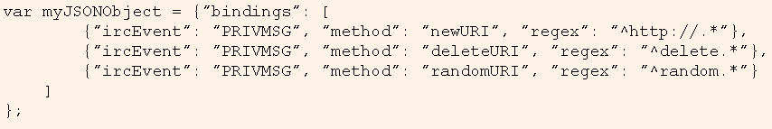
JSON – And JavaScript
AJAX Frameworks
JSON is a subset of the object literal notation of JavaScript.
Use {} for object; [ , ] for array; name:data for data fields.
IK 2010-2018

Slide 48
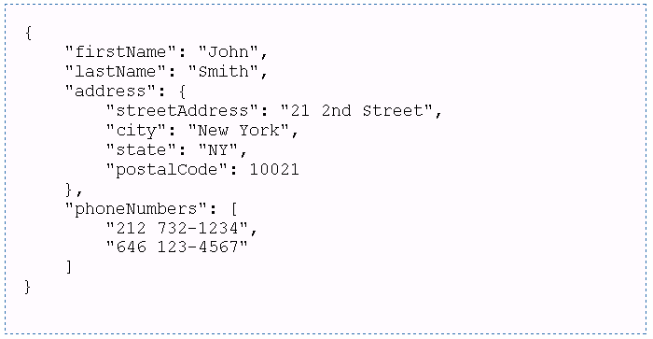
JSON – one more example
AJAX Frameworks
IK 2010-2018

Slide 49
JS and JSON
From JSON string to object: JSON.parse()
From object to JSON string: JSON.stringify()
var obj = JSON.parse('{ "name":"John", "age":30, "city":"New York"}');
var myJSON = JSON.stringify(obj);
IK 2010-2018

Slide 50
PHP and JSON
JSON string into a PHP object: json_decode()
PHP object or array into JSON: json_encode()
$data = '{ "name": "Aragorn","race": "Human"}';
$character = json_decode($data);
echo $character->name;
echo json_encode($my_data);
IK 2010-2018

Slide 51
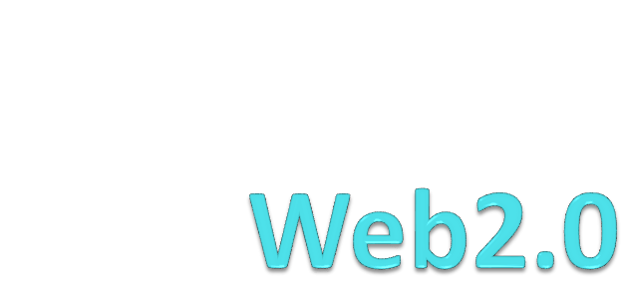
IK 2010-2018

Slide 52
What is Web2.0
Web2.0
A buzz word…
It is a type of Web sites where the main content was created by users, not by site owners or paid staff.
Contains some real technologies, some new packages for known technologies, and the rest is a methodology.
RIA, XML, JavaScript, RSS and Ajax, smooth edging, blogs and open interfaces.
IK 2010-2018

Slide 53
What is Web2.0
Web2.0
www.youtube.com – web 2.0
www.amazon.com – web 1.0
Wikipedia -?
Ynet - ?
Facebook - ?
CNN - ?
IK 2010-2018

Slide 54
We was covered…
Web2.0
We have covered the technology that empowers web2.0.
  Ajax.
  Enhanced JavaScript. (OOP, JSON).
  AJAX with JQuery
IK 2010-2018

